Slide 1
A very brief look at how library and archives have cataloged their collections...
and how those catalog records can be seen as data
Prepared by the project team of From Collection Records to Data Layers: A Critical Experiment in Collaborative Practice, University of Pittsburgh, October 2019
Notes:
Our Collections as Data project proposes that when you are working with library and archival material in a data context, you should start by building upon existing data that has already been collected by the library. For anyone who does not work as a librarian or archivist, the nature of this catalog data can seem quirky and strange. To be honest, some parts of it seem strange for professional librarians, too. But we believe it's important to have a little bit of context about how and why libraries and archives catalog their collections, and how these collection records can be seen as data.

Slide 2
We'll start with collections of books (and book-like things)
Notes:
To start, it’s important to know that libraries and archives describe different kinds of material differently. This applies not only to how items are described, but also the formats and systems in which the descriptions are stored. Moreover, there are big differences in the granularity of description -- meaning, for example, whether or not individual items that make up a collection are described at all.
There is a long history here that is influenced by technology, formats, scale, evolving professional standards, and more. We'll start this by looking at books and related book-like things. To begin, we'll go back around 2,300 years...

Slide 3
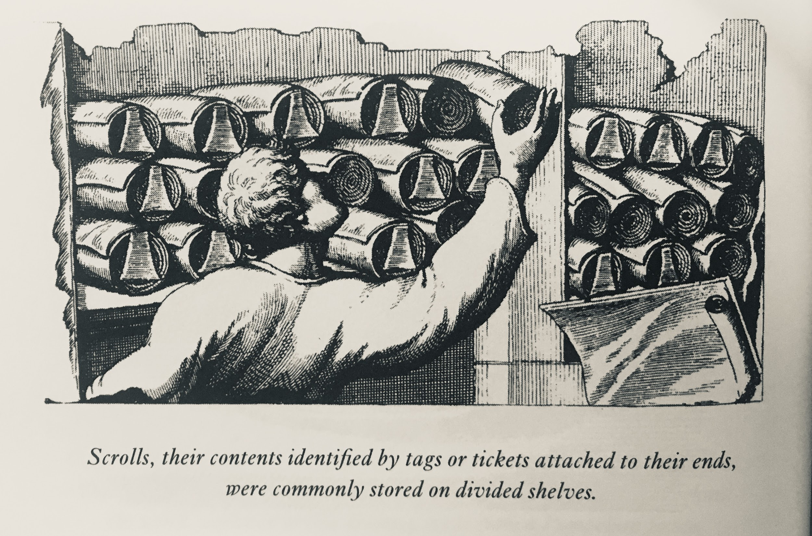
In The Book on the Bookshelf, Henry Petroski, Knopf, 1999.
Notes:
Before the codex form of a book became the prevalent form (i.e., two covers, separate leaves of pages in between), scrolls were often used to hold writing that was meant to last. Scrolls were stored on shelves; it would have been a bit of a hassle to unfurl a scroll to learn what it contained. So, as this illustration shows, an early form of book cataloging involved the creation of tags that could be attached to the ends of scrolls laid on shelves. These would not have been complex descriptions, and they would not have followed any shared standards. They were driven by a very localized utility. But these tags were an early form of collection data!

Slide 4
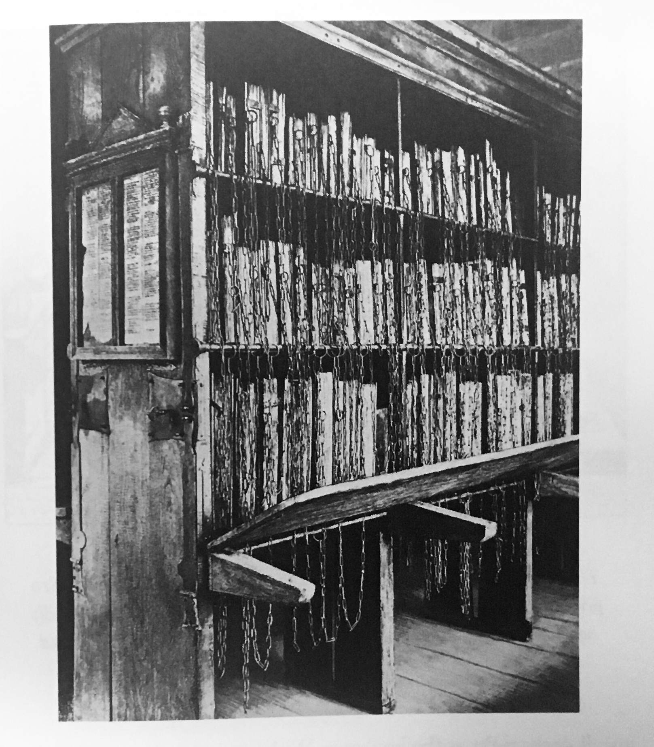
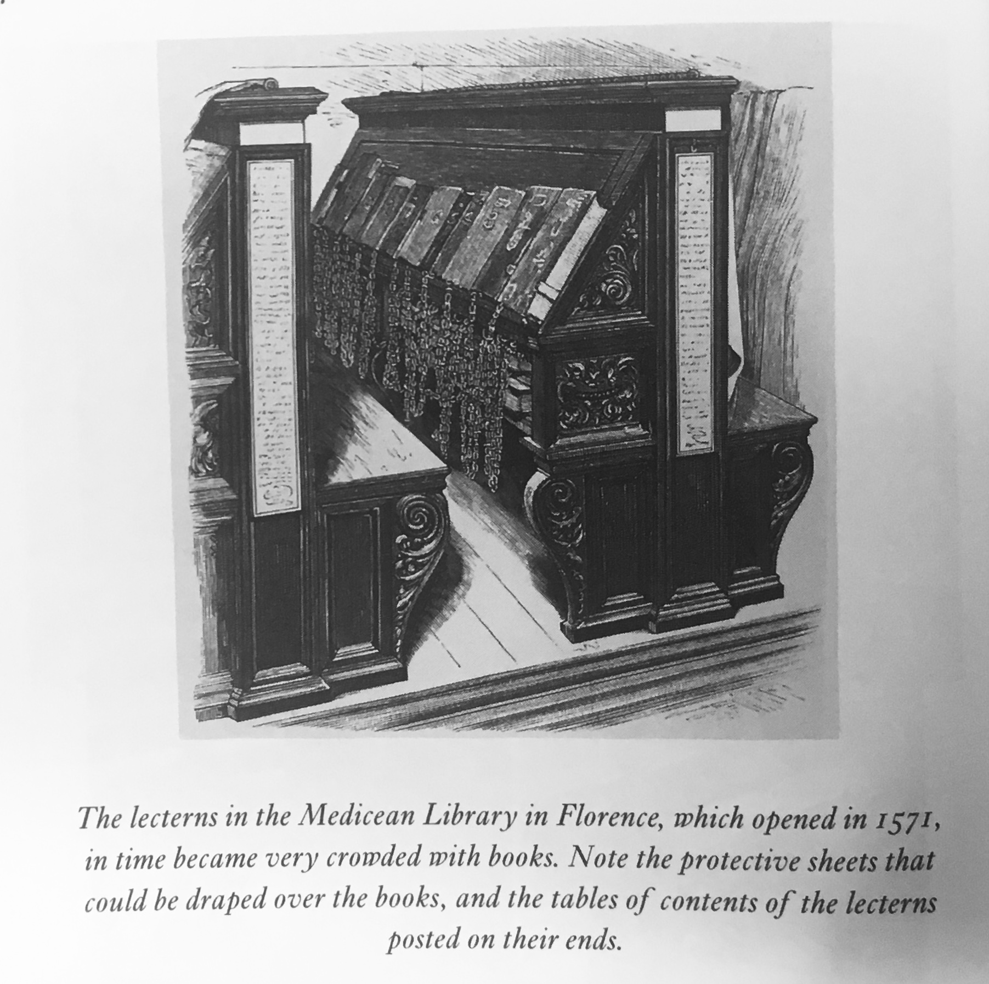
In The Book on the Bookshelf, Henry Petroski, Knopf, 1999.
Notes:
As the technology of books changed, the dominant physical form of books changes from scrolls to the codex. In codex form, books could stand upright on shelves. However for a long while books were so precious that libraries often chained them to the shelves so they would remain there. Also, perhaps surprisingly, in early practice the spines of books were considered an insignificant structural component. As such, books were often stored with their spines inward.
In this era of libraries, reading the spines was not a way of locating a book; instead, the ends of the shelves were used to hold contents lists of what they contained. You can see examples on the illustrations here. Very slowly, libraries began to create separate catalogs that took the form of inventory lists.

Slide 5
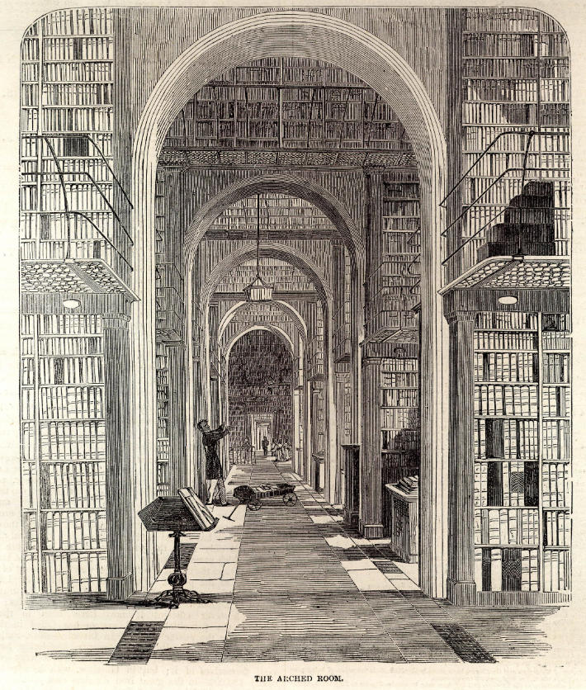
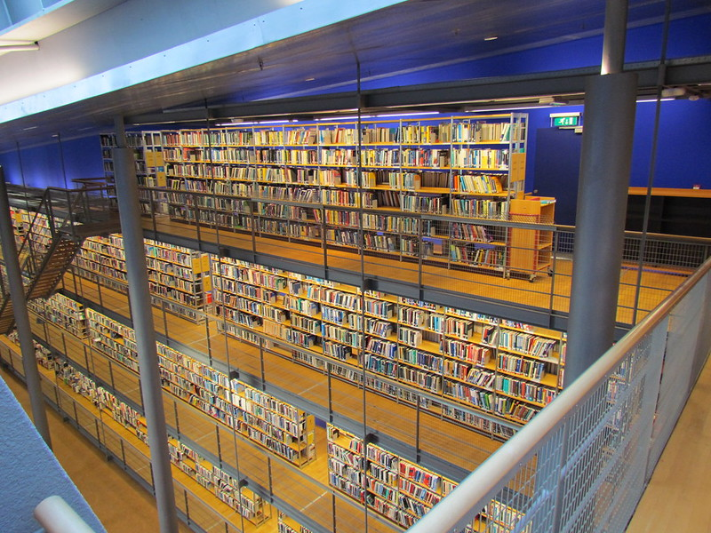
https://www.bl.uk/collection-items/the-arch-room
https://www.flickr.com/photos/48209549@N02/7505332498/
Notes:
Through a number of factors — the mechanical printing press being one of the largest — the scale of library collections continued to grow in dramatic fashion. We're skipping over many years, but by the 20th century it was common for academic research library collections to hold millions of books each. With so many books to manage, and so many being added all the time, it’s clear that hand-written inventories would no longer be up to the task.

Slide 6
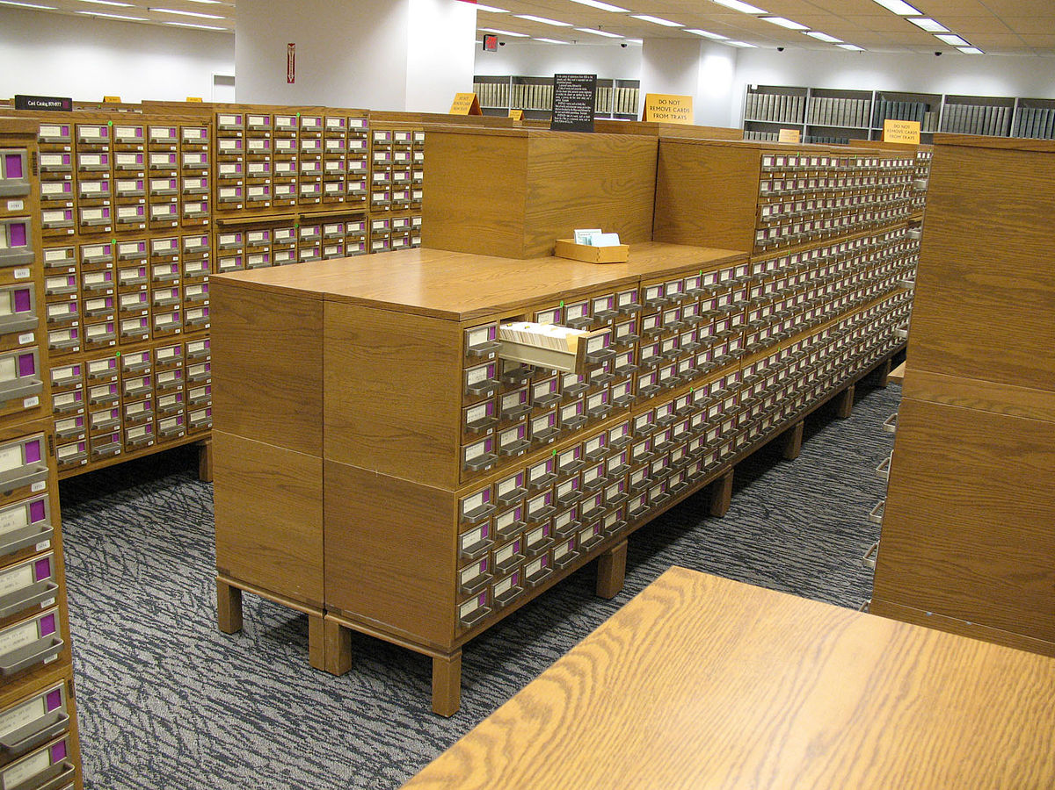
Notes:
Card catalogs were the culmination of many threads of standardization and shared practice. Look at the physical form of the card catalog here. You can see right away that this system is based around a standard physical form for each record (the card), and the records are stored in standardized physical containers (the card drawers). On the cards themselves, there was an increasing standardization in what information was recorded and how it was written.
Card catalogs are enormous analog databases, and their structures had a huge influence on the digital library catalogs that eventually replaced them.

Slide 7
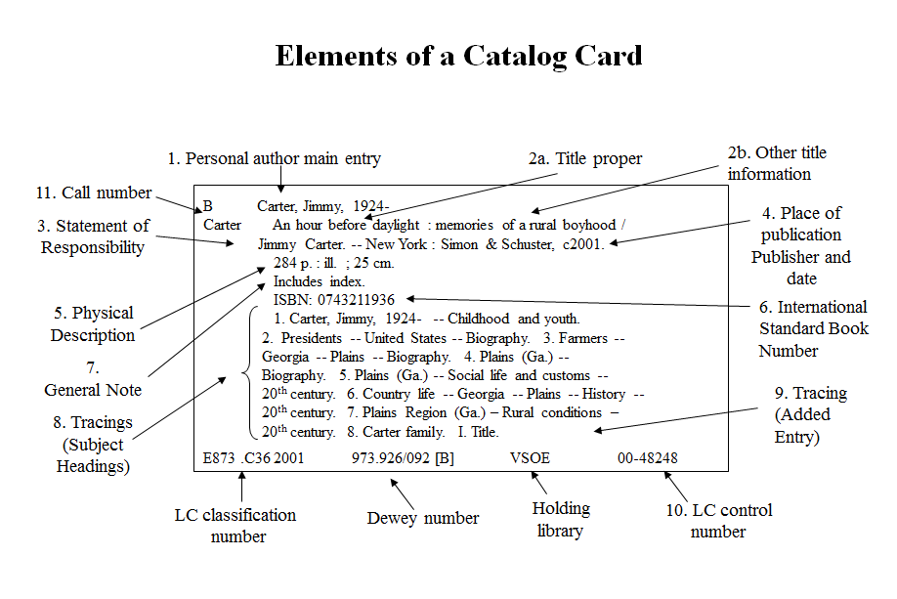
https://www.librarian.net/talks/marcmetadata/
Notes:
This diagram of a catalog card is presented to show you that it is designed to hold highly structured and controlled information. Although it doesn't look like a form — there are no field labels, no visible tables or spreadsheet cells — those structures are there underneath.
Also note that the physical limitations of the card mean that information has to be recorded in compact form. There are certain fields that are included — ones that we presume the cataloging practice feels are most important — but there's not room for much else. Also note that there are many codes in use: the ISBN, the LC classification number, the Dewey classification code, a code for the holding library, and so on. These codes enable certain efficiencies around data management, but they are challenging to comprehend for non-specialist users.

Slide 8
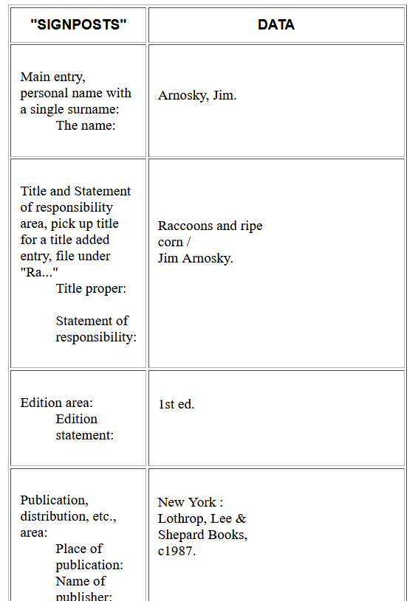
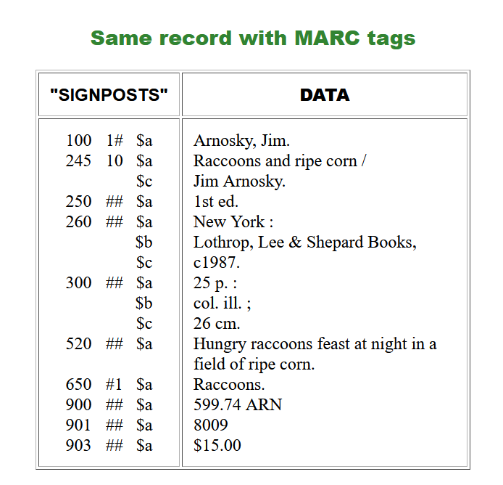
Notes:
It should be no surprise that the explosion of computers, digital storage, and electronic networks had a huge impact on libraries and library catalogs. As with many existing technologies that become mechanized, automated, and/or digitized, the first form of computerized catalog records was in many ways a re-mediation of print records in the new mode (think "horseless carriage"). A standard format was created: MAchine-Readable Cataloging, or MARC. Here you can see how the structure of data that existed on the catalog cards was made more explicit and even more coded. The table on the left is a "human readable" listing of MARC fields and sample data. On the right, we see how that structure is encoded in MARC: using specialized numeric fields and subfields required for a valid MARC record.
MARC is still used by most libraries in the United States. However, over the last few decades, there have been many conversations in the profession about other data structures. All this work predates the World Wide Web.

Slide 9
library catalogs treat serials (newspapers, magazines, journals) in a particular way:
Notes:
As we move on from books, it's important to know that libraries catalog serials (things that are issued in continuing series, like newspapers, magazines, and journals) in a particular way.

Slide 10

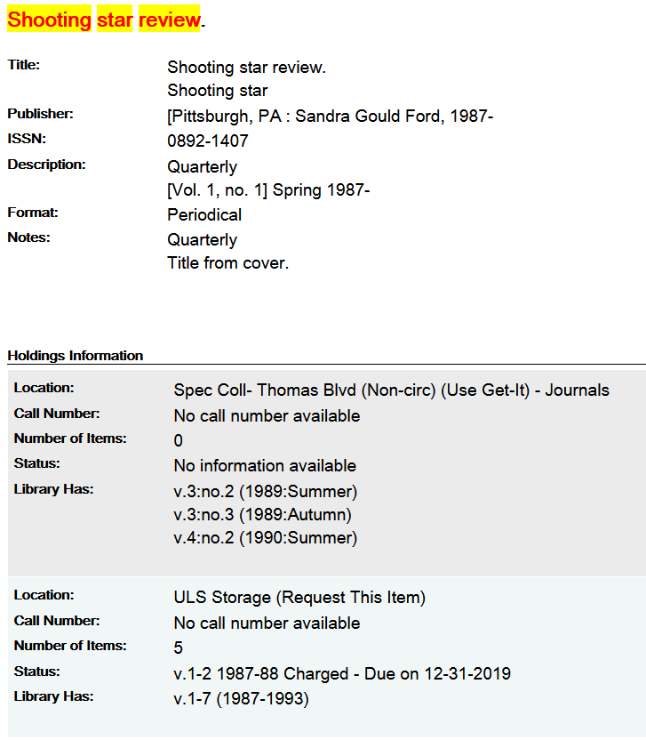
Notes:
Look at this catalog record for the Shooting Star Review. Notice that there is only one record for the entire magazine. Can you easily tell what volumes and issues exist? Is it a complete listing of everything the magazine published? Do you see any information about the specific contents of any issue?
Serials are cataloged in MARC, but the data model provides very little information about any particular issue. Many (but not all) serials are indexed or provided as full-text in databases, but these are often commercial products produced by third-party (not library) vendors.

Slide 11
But wait, with archives it's totally different!
Notes:
At this point, we've talked a little bit about how libraries describe books and serials. But many research libraries also contain archives, which hold collections of letters, personal papers, photographs, and other unique material. Archival collections, and the content they contain are described in a very different way!

Slide 12
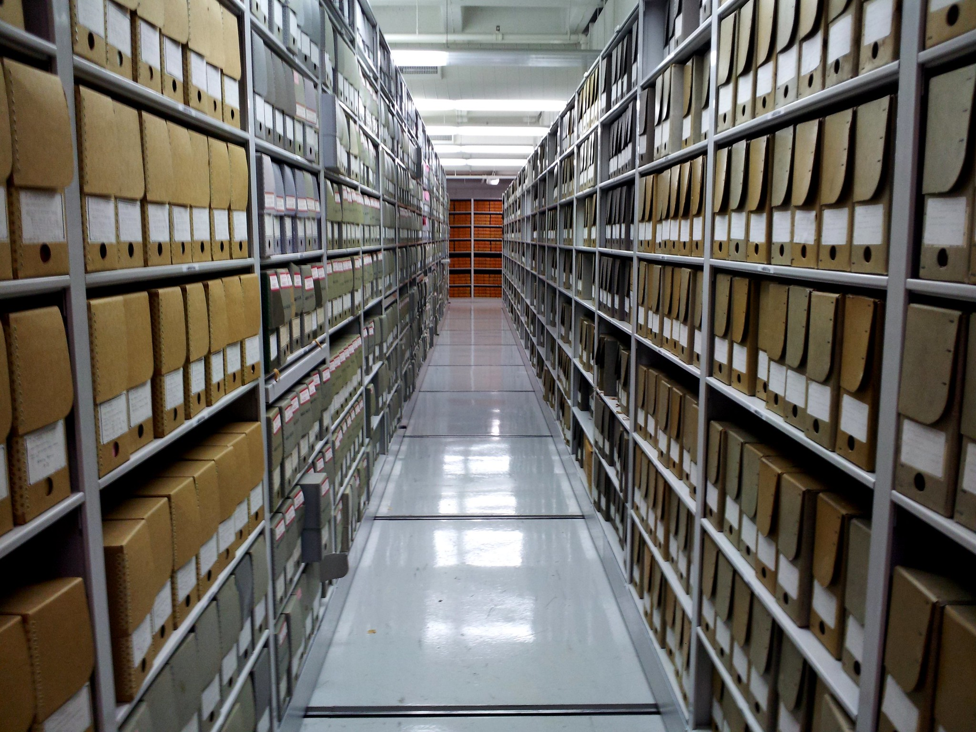
https://www.flickr.com/photos/schuminweb/10159531696
Notes:
This is what we're talking about — this is a photo of some shelves at the US National Archives. Notice there are repeating units here, but they are not books or journal articles. Instead, they are boxes, usually containing folders, that store many different kinds of content within. Also important, but not obvious, is that these boxes are part of larger archival collections. These larger collections are in fact the fundamental units of archives, and boxes (or other containers) the secondary units within. Let's see what this looks like for description in practice:

Slide 13
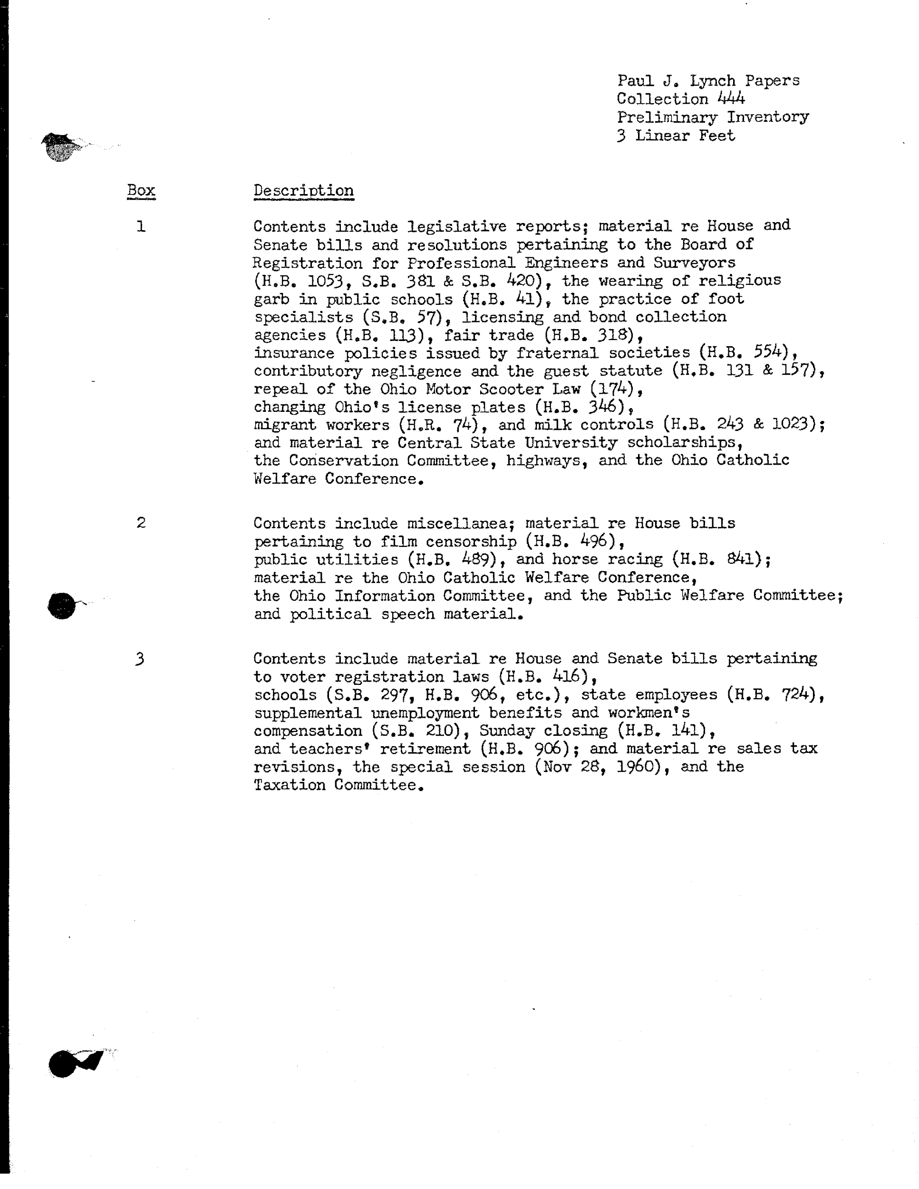
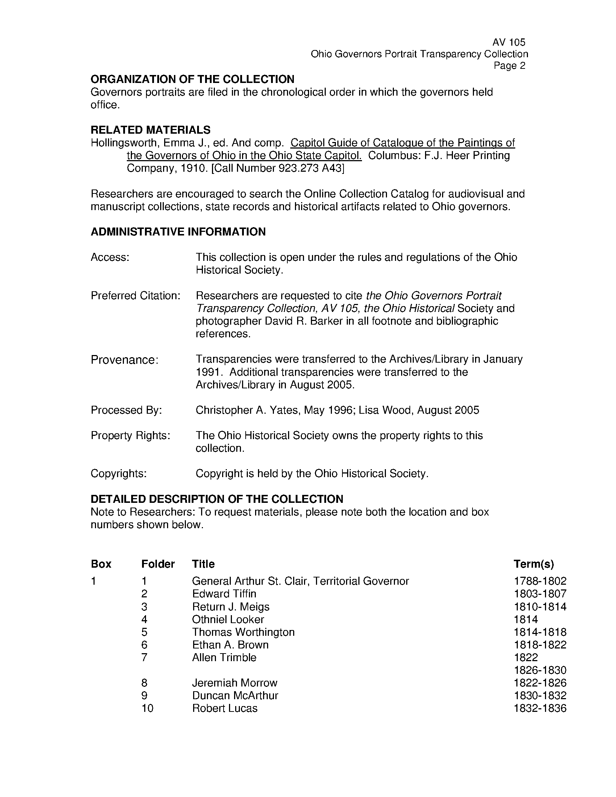
https://ohiomemory.org/digital/collection/aids/id/2965/
https://ohiomemory.org/digital/collection/aids/id/4623/rec/5
Notes:
Although archival collections can have a library catalog record, similar to a book, the most meaningful catalog to an archival collection is something different: it is a document known as a finding aid. As with book catalog records, finding aids had a long tradition as an analog print format before becoming digital.
Here are two examples of paper finding aids. The one on the left is for a full collection of three linear feet of material. Note how much summarization is happening in statements that start with "Contents include...". Also note that while there is some structure to this record, much of the description is narrative. This is typical of finding aids, which are usually a mix of narrative and more structured inventory sections. The finding aid example on the right is only a portion of a larger document; note that there is a little more structure visible — you can see field labels and corresponding values (e.g., “Provenance”, “Copyrights”) that look like structured data.

Slide 14
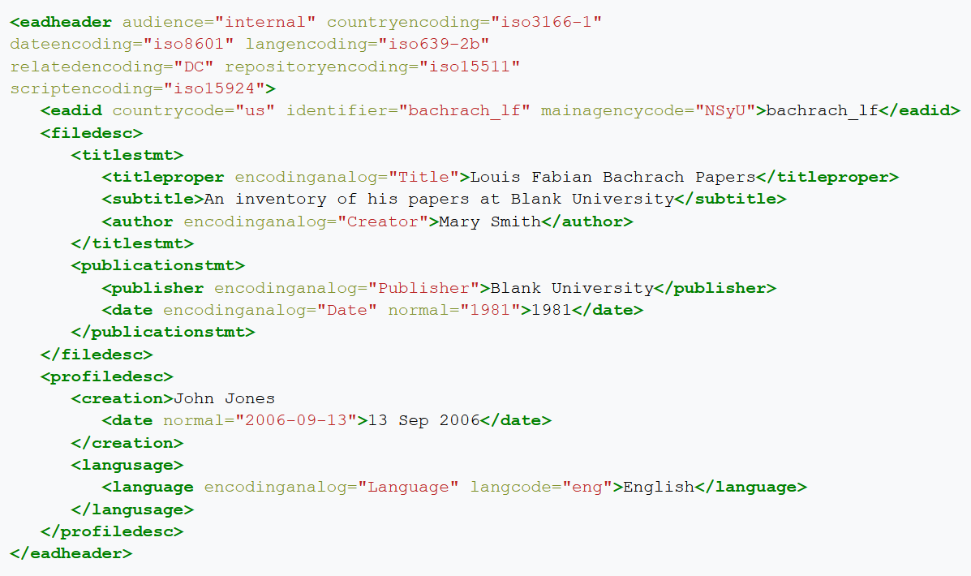
https://en.wikipedia.org/wiki/Encoded_Archival_Description
Notes:
We already looked at MARC, the digital form of library catalog records. There is a corresponding digital format for archival finding aids. In this case, the format uses another acronym: Encoded Archival Description, or EAD. Because of the document-like structure of paper finding aids, EAD could not have been designed as a tightly structured row and column data format. Instead, it uses XML (eXtensible Markup Language), an encoding technology that wraps tags around text in the same way that HTML encodes web pages.
As you can see in this example, the encoding allows for both specific data labelling (note tags like "date", "author", and "titleproper"), as well as a flowing, tree-like document structure. When archives present digital finding aids to their users, they are not presenting this form of EAD. Instead, the code here is transformed into a web page, a PDF document, or similar. But if you are thinking about how to pull existing information about archival collections as data, it’s important to be aware of EAD and its structure.

Slide 15
And with digitized library material, it's (kind of) different again!
Notes:
To this point we have talked about how libraries and archives developed formats and standards for describing their analog collections. Even when those catalog records took digital form, they were still influenced by the professional practices that developed in managing physical materials.
As libraries began to develop their own digital collections, different formats and practices for description emerged. They are still very much in line with the kind of structures and technology we've already seen, so in some ways they are only "kind of" different. They use a slightly different flavor of record encoding, but another key difference is the granularity of description. More on that next.

Slide 16

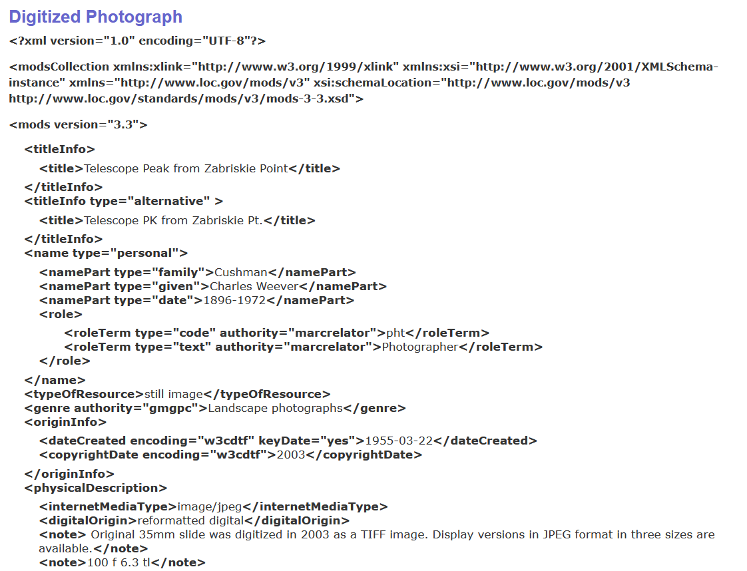
https://www.loc.gov/standards/mods/userguide/examples.html
Notes:
When libraries create digital objects, there is no physical object to place on a shelf or into a storage box. Because of this, there is a greater need to describe each individual item. If the digital item is a book, item-level description might already exist in the MARC catalog record. However, in many cases the item is something that would not have traditionally been described at item level.
For example, consider a photograph that is part of a larger archival collection. Or an individual issue of a magazine or newspaper. As we've already discussed, individual objects of these kinds are typically not described in much detail in catalog records and archival finding aids. As as result, they don't quite fit into the existing cataloging formats that we've already covered. In response, the library and archives communities created more standards, specifically for describing digital objects. One of these is shown here: the Metadata Object Description Schema, or MODS. This is a standard that is very similar to MARC, but simplified in some ways, and better able to accommodate the variety of material that might make up a digital collection. Note it is also based on XML markup, similar to what we have seen already with EAD.

Slide 17
In summary:
library and archives catalogs provide a lot of valuable data.
But the information recorded, formats used, and granularity of description are highly varied. They are shaped by long histories of changing technologies, tools, scale, standards, professional practices, etc.
Notes:
To summarize what we've already covered: libraries and archives put huge effort into cataloging and describing the materials they collect. These catalog records contain a wealth of data that may be useful when you work these materials using data-focused methods. However, there is a huge variety in what library and archival descriptive data looks like in practice. Depending on what is being cataloged, there are differences is what is recorded, what format it is stored in, and whether or not an individual item is captured in any detail. All of these differences have been shaped by a long history of changing technologies, tools, the scale of collections, standards uses, professional practices, and more.

Slide 18
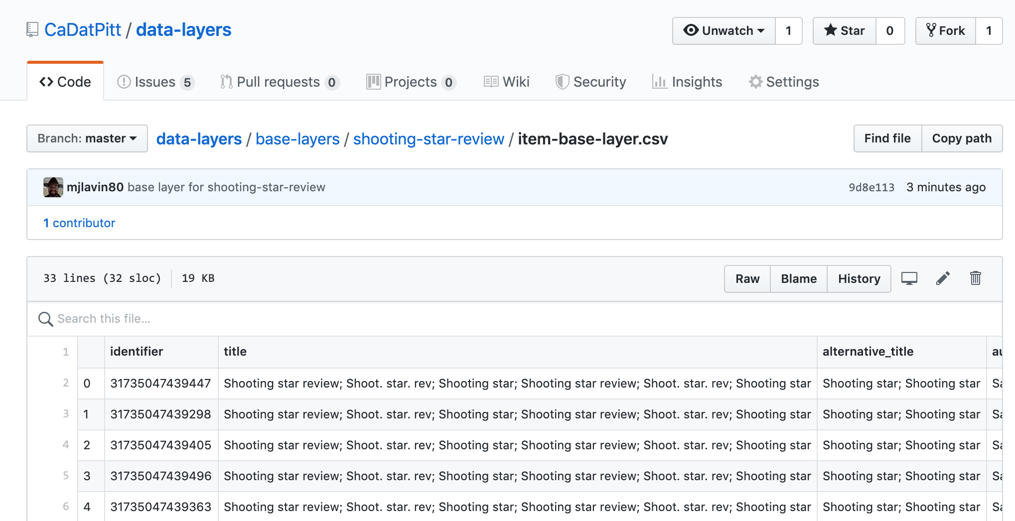
Simplifying library and archives data to make it more accessible: the "base layer"
Notes:
This all may sound daunting, and it can be in practice. To address this, our project has worked to create a simplified, standardized presentation of library and archives catalog data. We have chosen a single, simple tabular format for item records. These plain-text comma separated values (CSV) files can be opened and modified with any spreadsheet application.
We understand that this library and archives data is likely to be the "base" on which you add additional data to support your research questions; as such, we call this the "base layer". Even in these base layers, you will see evidence of the variety and history of cataloging described in this slide deck. Some fields you consider important may be missing or blank; others may be driven by library and archival description standards that seem idiosyncratic or unimportant for your work. Hopefully, the background and historical context that has been shared here helps you to better understand and use what you'll find in the base layers.

Slide 19
References
EAD: Encoded Archival Description (EAD Official Site, Library of Congress). (n.d.).http://www.loc.gov/ead/
Harris, P. (n.d.). Quart into a pint pot: The accommodation problems of the British Museum Library | British Library - Picturing Places. from The British Library website: https://www.bl.uk/picturing-places/articles/quart-into-a-pint-pot-the-accommodation-problems-of-the-british-museum-library
Lanius, L. (2011). Introduction to MARC, Metadata, and RDA. https://www.librarian.net/talks/marcmetadata/
Library of Congress. (n.d.). Understanding MARC Bibliographic: Machine-Readable Cataloging. https://www.loc.gov/marc/umb/
Metadata Object Description Schema: MODS (Library of Congress Standards) (n.d.).http://www.loc.gov/standards/mods/
Petroski, H. (2000). The Book on the bookshelf. Vintage Books: New York.

